Slide 1
Week 01 Introduction to Object Oriented Programming

Slide 2
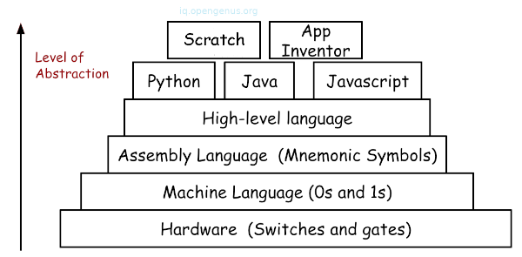
Introduction to Programming level/Generation
Notes:
Introduction to Programming levels/ Generation

Slide 3
Introduction to Programming level/Generation
Machine language
Operation code: such as addition or subtraction.
Operands: that identify the data to be processed.
Machine language is machine dependent as it is the only language the computer can understand.
Very efficient code but very difficult to write.
Assembly languages
Symbolic operation codes replaced binary operation codes.
Assembly language programs needed to be “assembled” for execution by the computer. Each assembly language instruction is translated into one machine language instruction.
Very efficient code and easier to write.
Notes:
Introduction to Programming levels/ Genration

Slide 4
Introduction to Programming level/Generation
High Level Languages
Closer to English but included simple mathematical notation.
Programs written in source code which must be translated into machine language programs called object code.
The translation of source code to object code is accomplished by a machine language system program called a compiler.
Event based programming
A high level language (4GL) that requires fewer instructions to accomplish a task than a third generation language.
Used with databases
Query languages
Report generators
Forms designers
Application generators
Notes:
Introduction to Programming levels/ Genration

Slide 5
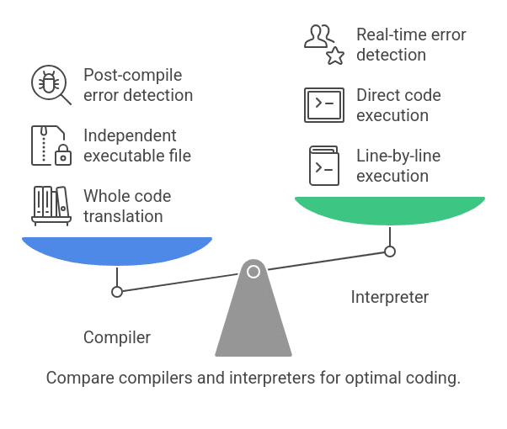

Slide 6
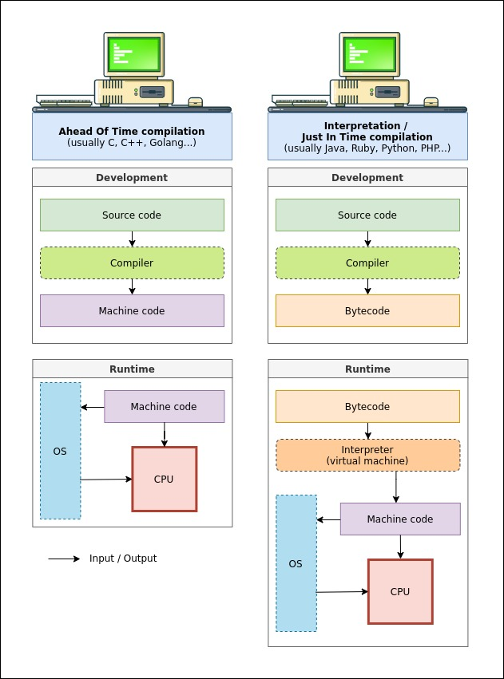
Source Code (.py) → Compiled to → Bytecode (.pyc) → Executed by → Python Virtual Machine (PVM)
Source code – the .py file you write
Compilation – Python's compiler translates this into bytecode (a set of instructions specific to the Python interpreter, not the actual hardware)
Execution – the Python Virtual Machine (PVM) reads and executes this bytecode line by line
write once, run anywhere

Slide 7
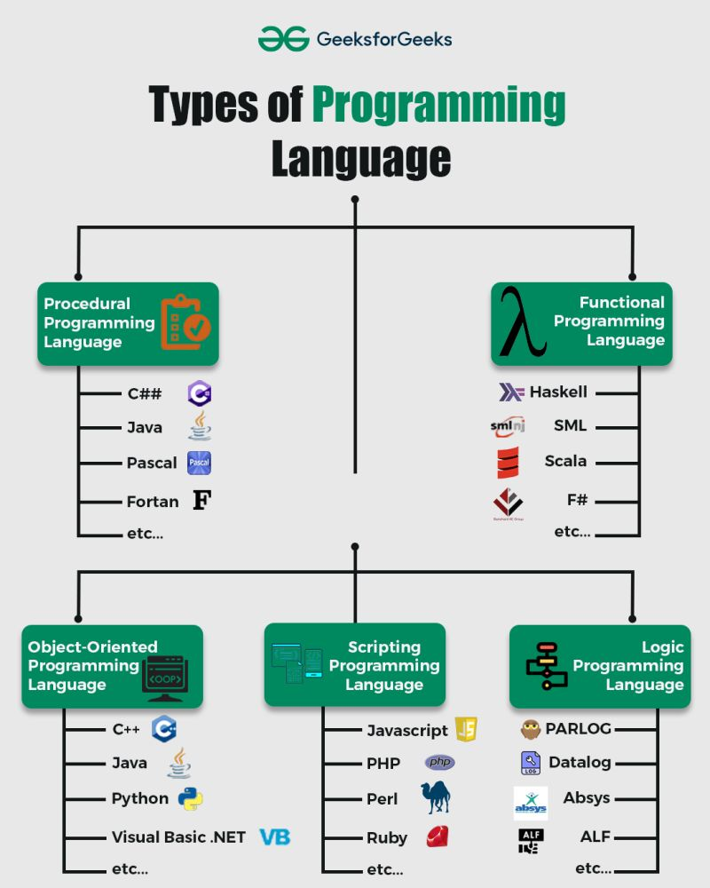
4. Scripting Programming
Idea: Scripting languages are commonly used to automate tasks or control other software/environments.
For example, JavaScript can be used to make a webpage respond when a user clicks a button.
User clicks button
↓
JavaScript runs
↓
Webpage changes
Scripts are often executed by a runtime environment rather than being used primarily to create standalone native applications.
Easy way to remember:
Scripting = "Use code to automate/control something."
1. Procedural Programming
Idea: A program is organized as a sequence of steps/procedures.
You tell the computer how to perform a task step by step.
Example:
1. Read two numbers
2. Add them
3. Store the result
4. Display the result
Procedural = "Do this, then this, then this."
5. Logic Programming
Idea: You describe facts and rules, and the system uses logical reasoning to find answers.
Instead of giving the computer a detailed sequence of instructions, you specify what is true and what rules apply.
For example:
Fact:
Socrates is a human.
Rule:
All humans are mortal.
Conclusion:
Socrates is mortal.
Prolog is another famous example of a logic programming language.
Easy way to remember:
Logic = "Give facts + rules → computer derives the answer."
3. Object-Oriented Programming (OOP)
Idea: Programs are organized around objects.
An object combines:
Data → attributes/properties
Behavior → methods/functions
For example, imagine a Student object:
Student
├── name
├── age
└── study()
Important OOP concepts
You will often encounter:
Class — blueprint for objects
Object — instance of a class
Encapsulation — keeping data and operations together
Inheritance — creating a class based on another class
Polymorphism — allowing the same interface to behave differently
OOP = "Organize programs around objects."
2. Functional Programming
Idea: Programs are built mainly using functions that transform data.
Instead of focusing on changing variables and program state, functional programming emphasizes what result should be produced from given inputs.
For example:
f(x) = x × 2
If x = 5, then:
f(5) = 10
Functional = "Apply functions to data."

Slide 8
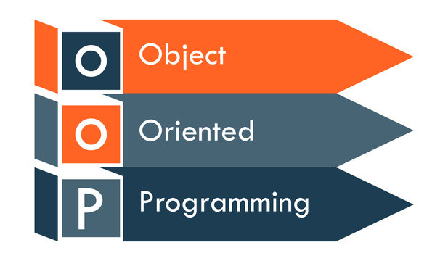
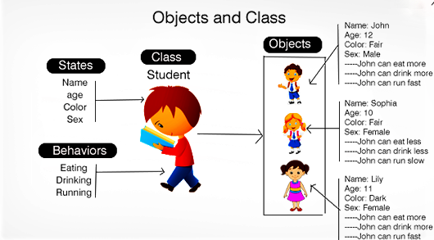
Introduction

Slide 9
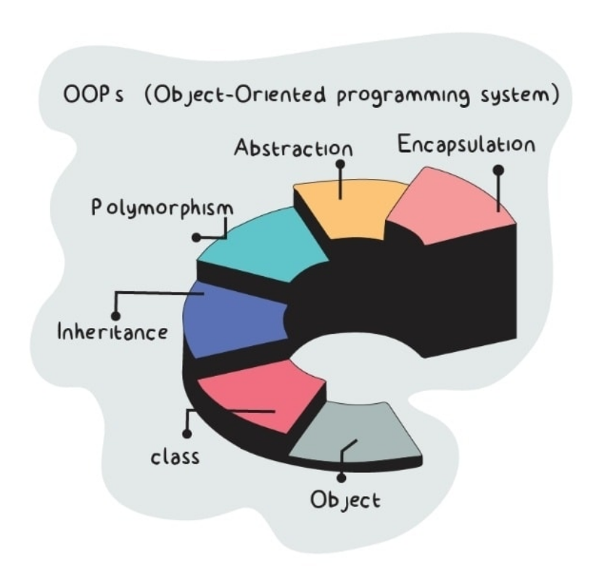
Five principles of OOP
1- Abstraction: To have the relevant information.
2- Encapsulation: To hide information inside the object.
3- Polymorphism: To have many shapes / behaviors.
4- Inheritance: To create a new object with an existing one (To adopt features from others)
5- Reusability: Ability to use an object again and again if needed.

Slide 10
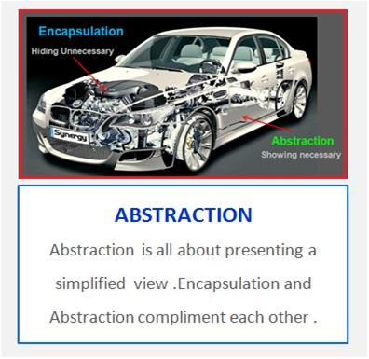
Five principles of OOP

Slide 11
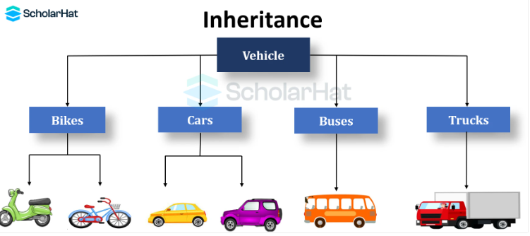
Five principles of OOP

Slide 12
